Slide 1
CS 310 Operating Systems Lecture 38: Input Output Concept, Buses, Processor Device Interaction
Ravi Mittal
IIT Goa

Slide 2
References
Book: Operating Systems: Three Easy Pieces, OSTEP, by Remzi H. Arpaci-Dusseau and Andrea C. Arpaci-Dusseau
Book: Operating Systems: Principles and Practice: Thomas Anderson and Michael Dahlin, Part 4
CS162, Operating Systems and Systems Programming, University of California, Berkeley
CS4410, Operating Systems, Course, Cornell University, Spring 2019,

Slide 3
In this lecture, we will study
Input-Output Concepts
Buses
Processor Device Interaction
I/O Instruction
Memory Mapped
Programmed I/O (Polling), Interrupt Driven I/O, DMA

Slide 4
Input - Output Concepts

Slide 5
Recall: Five Components of a Computer
Components a computer needs to work
Control
Datapath
Memory
Input
Output
Computer
Processor
Memory
Devices
Control
Input
Datapath
Output
Ref: Morgan Rae Reschenberg, Course 61C, Univ of California, Berkeley

Slide 6
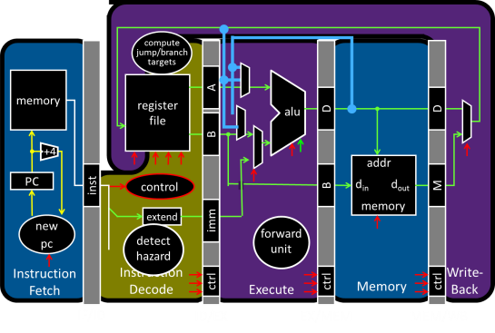
Recall: Big Picture: Input/Output (I/O)
How does a processor interact with its environment?
Computer System =
Memory + Datapath + Control
+ Input + Output
Keyboard
Network
Disk
Display
Ref: I/O lecture, Prof Hakim Weatherspoon, Cornell Univ

Slide 7
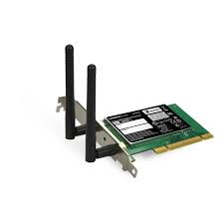
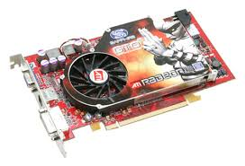


Recall: OS Basics: I/O
OS provides common services in the form of I/O
Threads
Address Spaces
Windows
Processes
Files
Sockets
Software
OS Hardware Virtualization
Hardware
ISA
Memory
Processor
Protection Boundary
OS
Ctrlr
storage
Networks
Displays
Inputs
Adapted from lectures CS162 at UC Berkeley, 2020

Slide 8
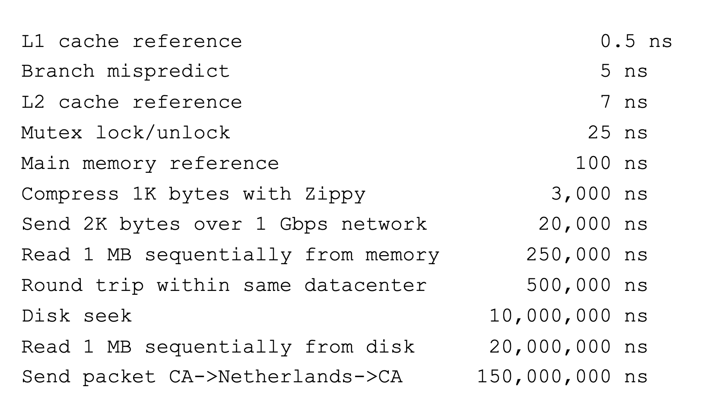
And Range of Timescales
Key Stroke / Click
100 ms
Adapted from lectures CS162 at UC Berkeley, 2020

Slide 9
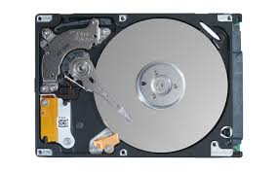
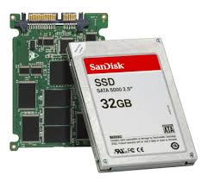
In a Picture
Read / Write
wires
Processor
I/O
Controllers
Secondary Storage (Disk)
Core
L2 Cache
Registers
L1 Cache
interrupts
Secondary Storage (SSD)
Main
Memory
(DRAM)
Read / Write
DMA transfer
L3 Cache (shared)
Core
L2 Cache
Registers
L1 Cache
I/O devices are supported by I/O Controllers
Processors accesses them by reading and writing IO registers as if they were memory
Write commands and arguments, read status and results
Adapted from lectures CS162 at UC Berkeley, 2020

Slide 10
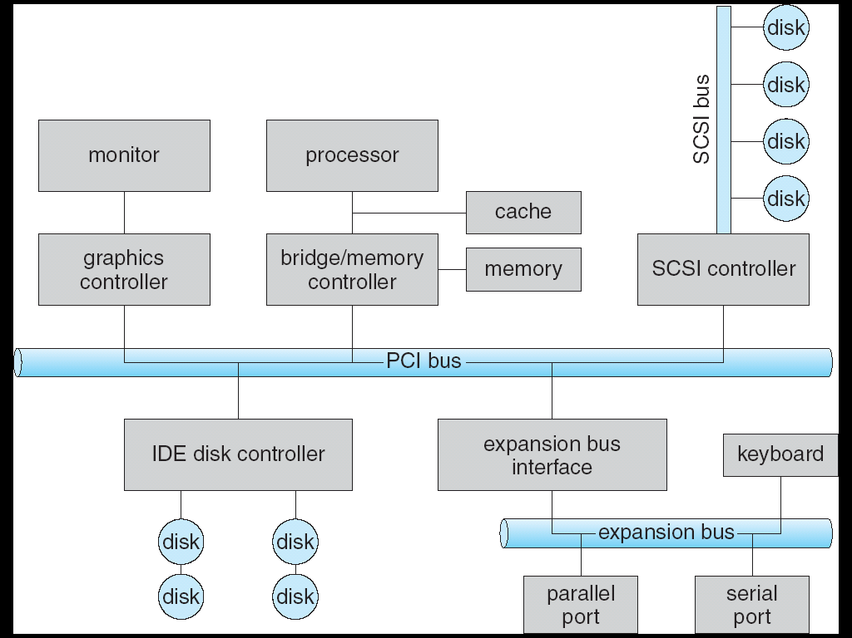

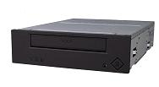
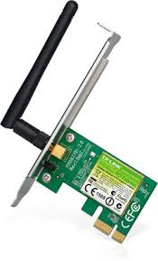
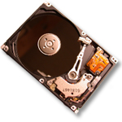

Modern I/O Systems
network

Slide 11
Buses

Slide 12
Buses
CPU
System bus
Bridge
PCI bus
Memory
Controller
Controller
Controller

Slide 13
PCI Express Bus
Serial, point-to-point, switched bus, non-shared connections between devices
Similar to switched Ethernet
Slow devices don’t have to share with fast ones
No longer a parallel bus
Star like architecture

Slide 14
Typical I/O system - Notes
Memory bus (system bus)
Proprietary, Fast, Small, costly, Very High Bandwidth
General I/O Bus
Example PCI or similar
Connects Graphics and other high performance I/O devices
Peripheral Bus
SCSI, SATA, USB etc
Connect slow devices such as disks, mice, keyboards
Advantages of Hierarchical System
Slow devices don’t impact performance
Many slow devices can be connected

Slide 15
Processor – Devices Interaction

Slide 16
Communication between the CPU and the I/O devices
Computer
Device Controller
Input/Output Device

Slide 17
How does the processor talk to the device?
Processor Memory Bus
Regular
Memory
CPU
Bus
Adaptor
Bus
Adaptor
Device
Controller
Address +
Data
Other Devices
or Buses
Bus
Interface
Hardware
Controller
Interrupt
Controller
Interrupt Request
read
Addressable
Memory
and/or
Queues
write
control
status
Registers
(port 0x20)
Memory Mapped
Region: 0x8f008020
Processor accesses registers in two ways:
I/O instructions: in/out instructions
Example from the Intel architecture: out 0x21
Memory mapped I/O: load/store instructions
Registers/memory appear in physical address space
I/O accomplished with load and store instructions
No extra instruction is required
Adapted from lectures CS162 at UC Berkeley, 2020

Slide 18
Memory-Mapped I/O: Display Controller
Memory-Mapped:
Hardware maps control registers and display memory into physical address space
Addresses set by HW jumpers or at boot time
Simply writing to display memory (also called the “frame buffer”) changes image on screen
Addr: 0x8000F000 — 0x8000FFFF
Writing graphics description to cmd queue
Say enter a set of triangles describing some scene
Addr: 0x80010000 — 0x8001FFFF
Writing to the command register may cause on-board graphics hardware to do something
Say render the above scene
Addr: 0x0007F004
0x80020000
Graphics
Command
Queue
0x80010000
Display
Memory
0x8000F000
0x0007F004
Command
0x0007F000
Status
Physical
Address
Space
Adapted from lectures CS162 at UC Berkeley, 2020

Slide 19
Programmed I/O, Interrupt Driven I/O, DMA
Notes:
is the standard state or behavior of an attribute

Slide 20
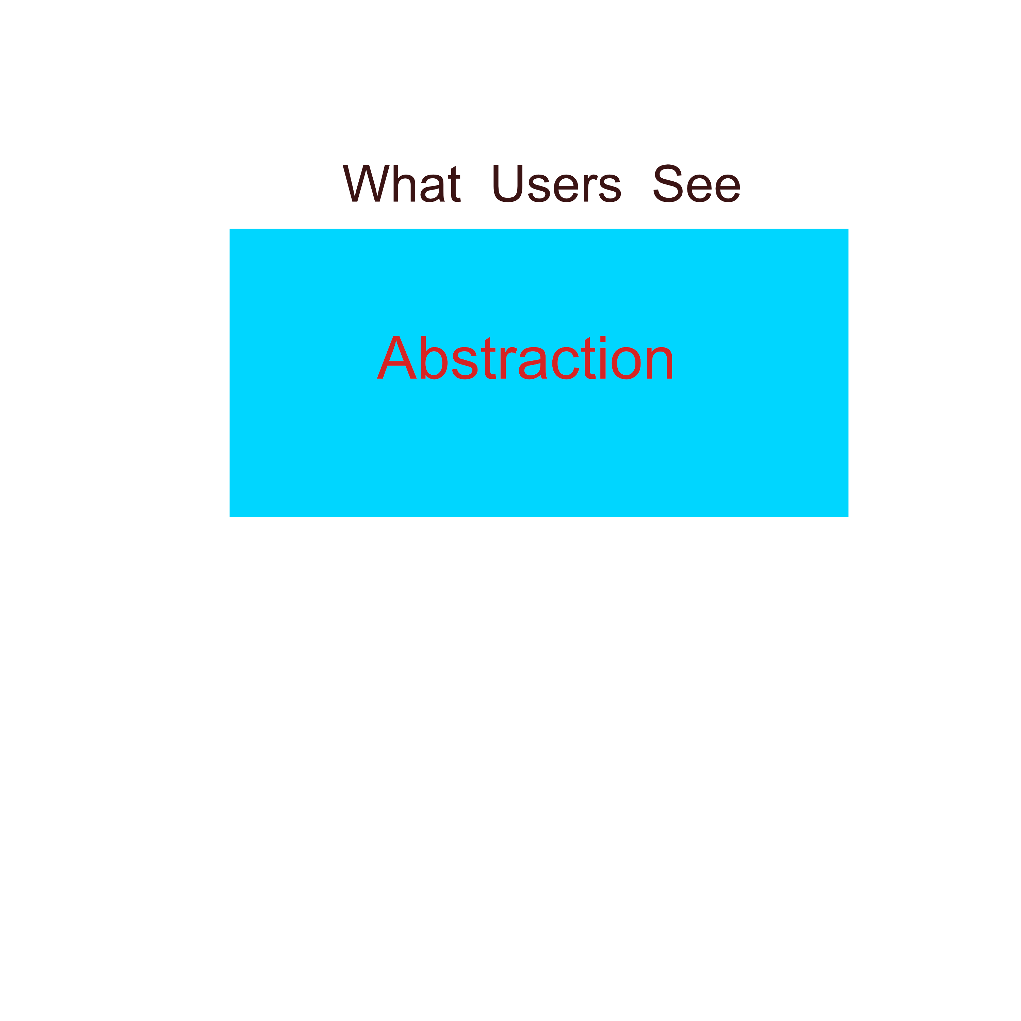
Interacting with a Device

Slide 21

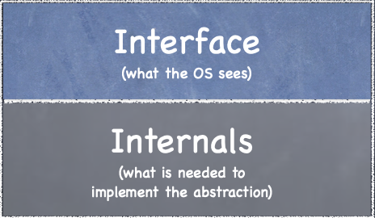
Interacting with a Device
All devices have some specified interface and protocol for interaction
A Device

Slide 22
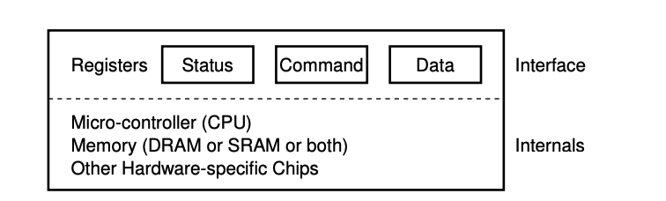
Interacting with a Device
All devices have some specified interface and protocol for interaction
Device Interface: 3 registers
Status Register: to see the current status
Command Register: to tell device to perform a certain task
Data Register: to pass data to device or to receive data from device
OS can control device behavior using these registers
Ref: OSTEP Book

Slide 23
Interacting with a Device – Programmed I/O
CPU is repeatedly reading status register to check if the device is free - Polling
OS sends some data down to the data register
Multiple such writes are needed to write a block (4KB) for disk
Here, main CPU is involved with the data movement
Programmed I/O
OS writes command to command register
It will lets the device know that both the data is present
it should begin working on the command
OS waits for device to finish by polling it in a loop – waiting to see it it has finished
OS controls device by reading/writing registers
while (STATUS == BUSY) ; // wait until device is not busy
write data to DATA register write command to COMMAND register
// starts device and executes command while (STATUS == BUSY)
// wait until device is done with request
Simple but inefficient;
Wastage of CPU time as OS keep polling
Ref: OSTEP Book

Slide 24
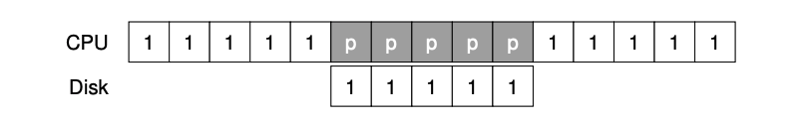
Interacting with a Device – Programmed I/O
Process 1 runs on CPU for some time
Issues I/O request to disk to read some data
System simply spins –polling status repeatedly
Shown as p – polling
The disk services the request and finally Process 1 can run again
Ref: OSTEP Book

Slide 25
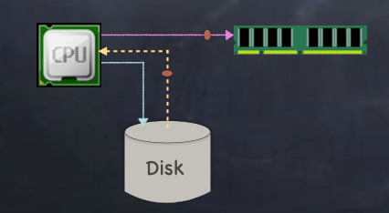
Interrupt Driven I/O
Device ←→ CPU ←→ RAM
for (i = 1...n) CPU issues read request
Device interrupts CPU with data
CPU writes data to memory

Slide 26
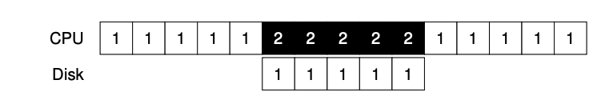
Interrupt Driven I/O
OS runs Process 2 on CPU when disk is servicing Process 1’s request
When request is complete the interrupt occurs, OS wakes up process 1 and runs it again
If device is fast, polling performs better than interrupt driven I/O
If device is slow, interrupt driven I/O is faster than polling

Slide 27
Interrupt Driven I/O
Livelock
A huge stream of incoming packets – each generating an interrupt
OS finds itself only processing interrupts
Not allowing a user process to run and actually service the request
It’s better to use polling
Both Programmed I/O and Interrupt driven I/O are not efficient as CPU gets busy doing mundane task
In both cases, CPU time is wasted

Slide 28
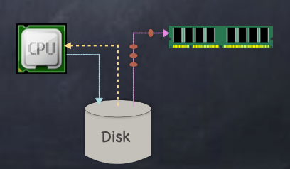
Direct Memory Access (DMA) I/O
Device ←→ RAM
CPU sets up DMA request
Device puts data on bus & RAM accepts it
Device interrupts CPU when done

Slide 29
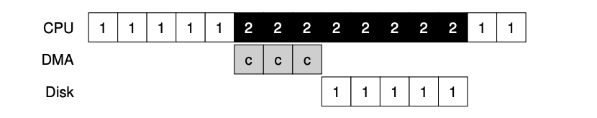
Direct Memory Access (DMA) I/O
Process 1 is running and it wants to transfer some data to the disk
It initiates I/O
Copy data from memory to the device explicitly
One word at a time (marked as c)
When copy is complete, I/O can begin on the disk
CPU can be used for something else say process 2
When transfer is complete, interrupt is raised and process 1 runs again

Slide 30
Direct Memory Access (DMA) I/O
DMA engine
A very specific device within a system that can orchestrate transfer between devices and MM without CPU intervention
To transfer data to device, OS programs DMA engine
Data location in the MM
How much data to copy
Which device to send it to
When DMA is complete, DMA controller raises an interrupt and the OS knows that the transfer is complete

Slide 31
I/O Device Notifying the OS
The OS needs to know when:
The I/O device has completed an operation
The I/O operation has encountered an error
I/O Interrupt: Device generates interrupt when it needs service
Handles unpredictable events well, but high overhead
Polling: OS periodically checks device-specific status register
Low overhead, but may waste cycles for infrequent or unpredictable I/O
Actual devices combine both polling and interrupts
E.g., high-bandwidth network adapter

Slide 32
Performance Concepts

Slide 33
Basic Performance Concepts
Response Time or Latency: Time to perform an operation(s)
Bandwidth or Throughput: Rate at which operations are performed (op/s)
Files: MB/s, Networks: Mb/s, Arithmetic: GFLOP/s
Start up or “Overhead”: time to initiate an operation
Most I/O operations are roughly linear in b bytes
Latency(b) = Overhead + b/TransferCapacity

Slide 34
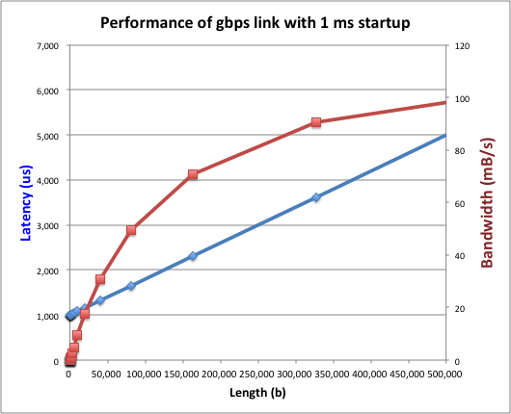
Example (Fast Network)
Consider a 1 Gb/s link (BW = 125 MB/s)
With a startup cost S = 1 ms
Latency(b) = S + b/BW
Bandwidth = b/(S + b/BW) = BW×b/(BW×S + b) = BW/(BW×S/b + 1)

Slide 35
Lecture Summary
Buses are evolving very fast – Shared → Switch
Device Controllers are used to help in communication between Processor and device
Processor accesses device registers (in controller) in two ways:
I/O Interrupt
Memory Mapped I/O
Interacting with a device
Programmed I/O
Interrupt driven I/O
DMA

Slide 36

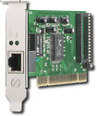
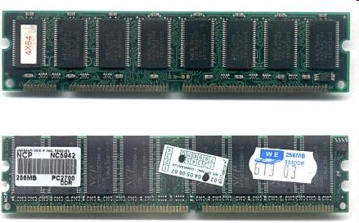
Kernel Device Structure
The System Call Interface
Process
Management
Memory Management
Filesystems
Device Control
Networking
Concurrency, multitasking
Virtual memory
Files and dirs: the VFS
TTYs and device access
Connectivity
Architecture
Dependent
Code
Memory Manager
File System Types
Device Control
Network Subsystem
Block Devices
IF drivers

Slide 37
Lecture Summary

Slide 39
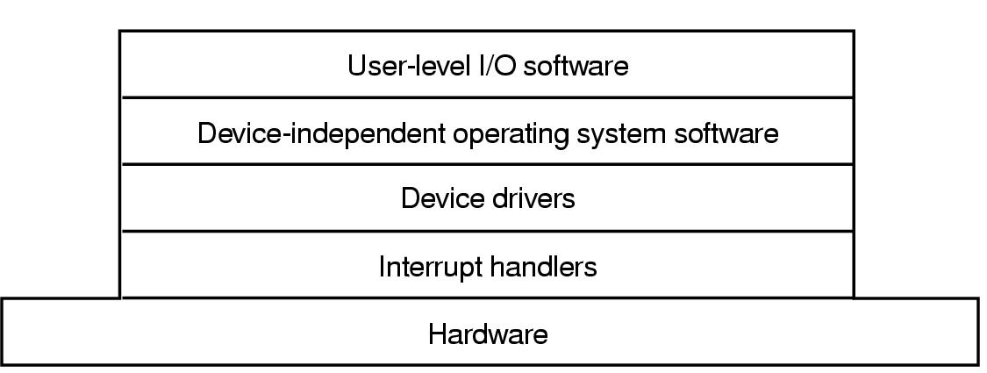
I/O Software Layers
Layers of the I/O Software System

Slide 40
Interrupt Handlers (Repeat)
Device drivers after starting an operation- blocks
On receiving an interrupt, the driver unblocks
Interrupt handling
Unlocks the driver (using semaphore)
A lot of other activities are done as a part of interrupt handling
Register Saving
Set up context for Interrupt service routine
Setting up TLb, MMU, Page Table
Set up stack for interrupt service-procedure
Ack the interrupt controller
Copy registers
Run Interrupt service procedure
Choose the process to run next
Set up MMU context for the process to run next
Load and run new process

Slide 41
Device Driver
The number of device registers and nature of commands vary radically from device to device
Mouse driver has to accept information from the mouse how far it has moved and which button is pressed
Disk driver have to know about sectors, track, cylinders, arm motion
each I/O device attached to a computer needs some device-specific code for controlling it
This code is the device driver
Device driver is generally written by the device’s manufacturer and delivered along with the device
Device drivers are supplied for OS
Each device driver usually handles one device type or class of closely related types

Slide 42
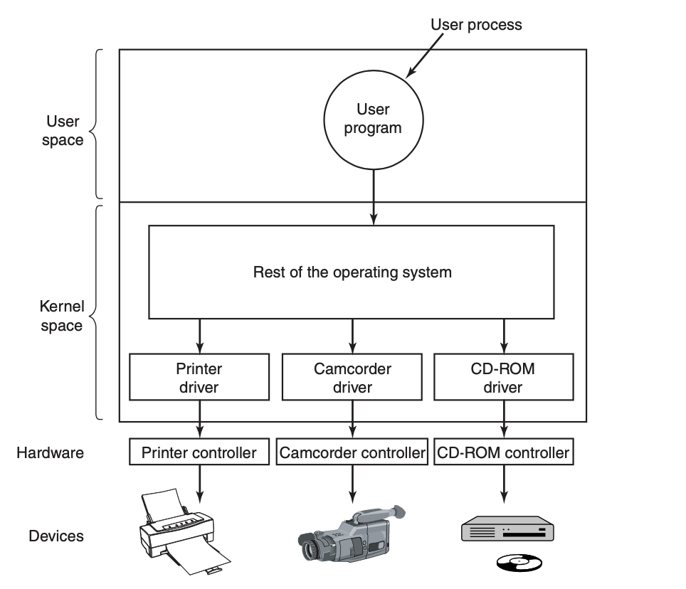
Device Driver
Device driver has to be part of OS
to access device’s hardware

Slide 43
Oss classify device drivers in to number of categories
Block Devices: Disks
Character Devices: Keyboards and Printers
Generate and accept stream of characters
Standard interface that all block drivers (and character drivers) must support
Number of procedures that rest of the OS can call eg read a block
to accept abstract read and write requests from the device-independent software above it
Execution of requests
Power management and logs

Slide 44
Device Driver – Functions (1)
Initialize the device
Check if input parameters are valid
If not error is generated
If inputs are valid, translation from abstract to concrete term
For a disk driver
Convert a linear block number to head, track, sector, and cylinder numbers
Check if the device is in use
If busy, the request is put in the queue
If Idle, hardware status is checked – if it can accept the request – there may be need to switch on the device etc
When device is free, actual control can begin

Slide 45
Device Driver – Functions (2)
Controlling a device -> issuing a sequence of commands
Driver issues commands
To drive a commend
Driver writes a command into device’s control registers
Once the command is accepted by the device, the controller issue more commands
Device driver waits until controller does some work on it
In some operations (eg screen scrolling), waiting is not required
Blocked driver is awakened by the interrupt by the controller
Driver checks for errors
If there is error, it passes it upwards
If everything is all right, the driver may have data to pass on to the device-independent software (eg block just read)
Selects next request for execution

Slide 46
I/O Software “Stack”
I/O API & libraries
User Level Software
Device Independent
Software
(Rest of the OS)
Device Drivers
Device Dependent
Interrupt Handlers
Device Dependent – as short as possible
Hardware

Slide 47
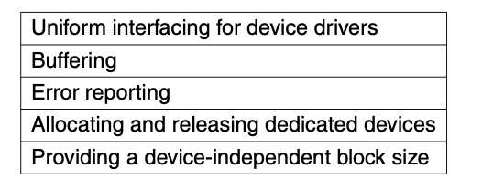
Device Independent I/O Software (1)
Function of Device Independent I/O SW
to perform the I/O functions that are common to all devices
to provide a uniform interface to the user-level software

Slide 48
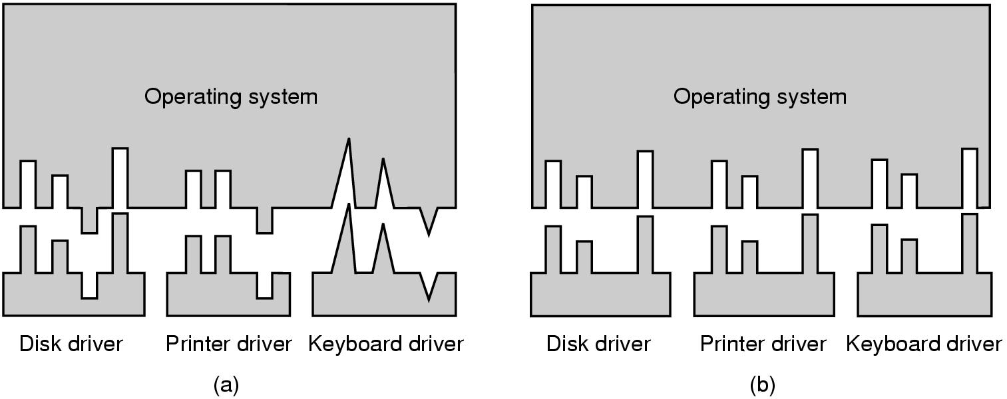
Device-Independent I/O Software (2) – Uniform Interfacing
(a) Without a standard driver interface
(b) With a standard driver interface

Slide 49
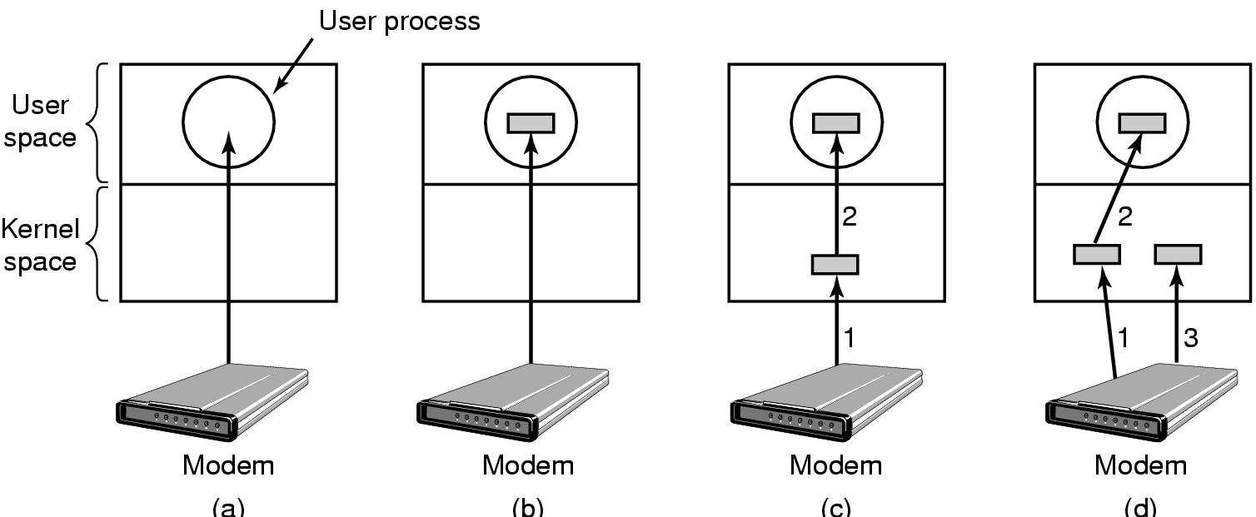
Device-Independent I/O Software (3) – Buffering
Buffering improves efficiency
(a) Unbuffered input
(b) Buffering in user space
(c) Buffering in the kernel followed by copying to user space
(d) Double buffering in the kernel

Slide 50
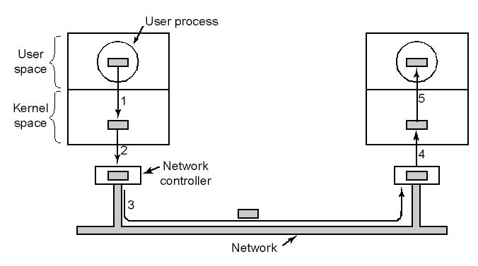
Device-Independent I/O Software – Sending packet on network – buffering
Networking may involve many copies

Slide 51
Error Reporting
Framework for error reporting
Device independent
Errors can happen in many ways
Programming Errors – eg writing to a keyboard etc
Trying to write to a disk block that has been damaged
Trying to read from a device that is switched off
Device specific errors may be handled by Device Driver
If it is not able to handle the error, it passes problem to device independent software. Solutions:
This software may inform user about the problem – eg using dialog box
Ignoring the error
Retry
Killing the process
Call fail with error code

Slide 52
Allocating and Releasing Dedicated Devices
Some devices can be used by a single process at a time
OS must examine requests – accept or reject them
There are many ways to do this
Perform open on a special file for the device directly
If device is unavailable – open fails
Special mechanisms for requesting and releasing dedicated devices
Block the caller process instead of failing – if device is busy
Put the process in the queue
When device is available, the first process in the queue is allowed to use it

Slide 53
Device Independent block size
Different disks may have different sector sizes
Device independent software hides this
It provides uniform block size to higher layers
Example: Treating several sectors as a single logical block
Allows higher layers to deal with abstract devices

Slide 54
User Space I/O software - Libraries
I/O API & libraries
User Level Software
Device Independent
Software
(Rest of the OS)
Device Drivers
Device Dependent
Device Dependent – as short as possible
Interrupt Handlers
Hardware
Libraries linked with user programs
System calls (including I/O system calls) are made by library procedures
Ex: printf("The square of %3d is %6d\n", i, i*i);

Slide 55
User Space I/O software - Spooling
I/O API & libraries, Spooling
User Level Software
Device Independent
Software
(Rest of the OS)
Device Drivers
Device Dependent
Device Dependent – as short as possible
Interrupt Handlers
Hardware
A way of dealing with dedicated I/O devices in a multiprogramming system
Spooled device – Printer
Consider a process opens a character special file associated with the printer and does nothing
Blocking other processes

Slide 56
Spooling
Spooling is a method for queuing and holding data for input or output
Uses special process called a daemon and special directory called spooling directory
To print a file a process
first generates the entire file to be printed
Puts the file in the spooling directory
Daemon is the only process that has permission to use printer’s special file
to print the files in the directory
It protects use of the special file directly by users

Slide 57
Spooling – Example (Aside)
Devices A to C request printing of data A to C almost simultaneously.
The spooler function saves the print data in the spooler in the order it receives it, and returns the printing results to each device.
Each device application completes the printing process and executes the next operation.
This product successively prints print data A to C.
The spooler function saves the printing results in the log.

Slide 58
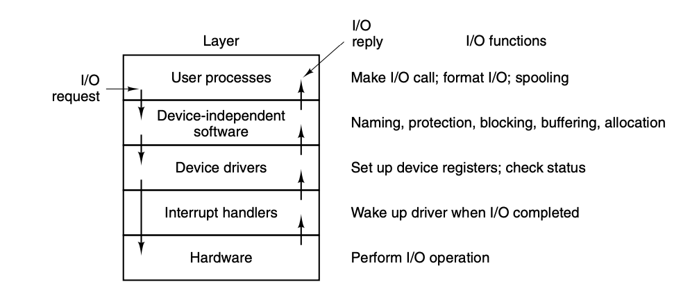
Main Functions of layers of I/O System

Slide 59
Lecture Summary

Slide 60
Device Drivers - USB
Sometimes widely different devices are based on the same underlying technology
Consider USB (Universal Serial Bus) Devices
Mouse, Keyboards, mini-fans, wireless network cards, keyboards, memory sticks, external disks, robots, credit card readers, bar code scanner etc
They all use USB ..yet do different things
USB drivers are stacked
Bottom layer – like Layer 2 of TCP/IP
Middle layer – handle packet transmission and reception
Higher layer = APIs such as mass storage, cameras etc
Separate device drivers

Slide 61
Device Drivers
Device Driver: Device-specific code in the kernel that interacts directly with the device hardware
Supports a standard, internal interface
Same kernel I/O system can interact easily with different device drivers
Special device-specific configuration supported with the ioctl() system call
Device Drivers typically divided into two pieces:
Top half: accessed in call path from system calls
implements a set of standard, cross-device calls like open(), close(), read(), write(), ioctl(), strategy()
This is the kernel’s interface to the device driver
Top half will start I/O to device, may put thread to sleep until finished
Bottom half: run as interrupt routine
Gets input or transfers next block of output
May wake sleeping threads if I/O now complete

Slide 62
Operational Parameters for I/O
Data granularity: Byte vs. Block
Some devices provide single byte at a time (e.g., keyboard)
Others provide whole blocks (e.g., disks, networks, etc.)
Access pattern: Sequential vs. Random
Some devices must be accessed sequentially (e.g., tape)
Others can be accessed “randomly” (e.g., disk, cd, etc.)
Fixed overhead to start transfers
Some devices require continual monitoring
Others generate interrupts when they need service
Transfer Mechanism: Programmed IO and DMA

Slide 63
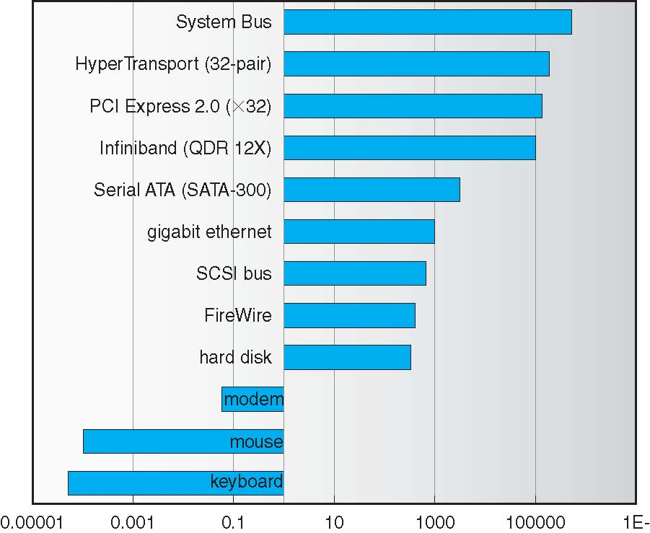
Example Device-Transfer Rates in Mb/s (Sun Enterprise 6000)
10m
Device Rates vary over 12 orders of magnitude !!!
System better be able to handle this wide range
Better not have high overhead/byte for fast devices!
Better not waste time waiting for slow devices

Slide 64
Typical I/O system - Notes
Memory bus
Proprietary, Fast, Small, costly, Very High Bandwidth
General I/O Bus
Example PCI or similar
Connects Graphics and other high performance I/O devices
Peripheral Bus
SCSI, SATA, USB etc
Connect slow devices such as disks, mice, keyboards
Advantages of Hierarchical System
Slow devices don’t impact performance
Many slow devices can be connected

